Slide 1

Data Link Layer
School of Computer Science Engineering and Technology Bennett University
Greater Noida – 201310

Slide 2
Outline
Data Link Layer: Services
Framing
Switches

Slide 3
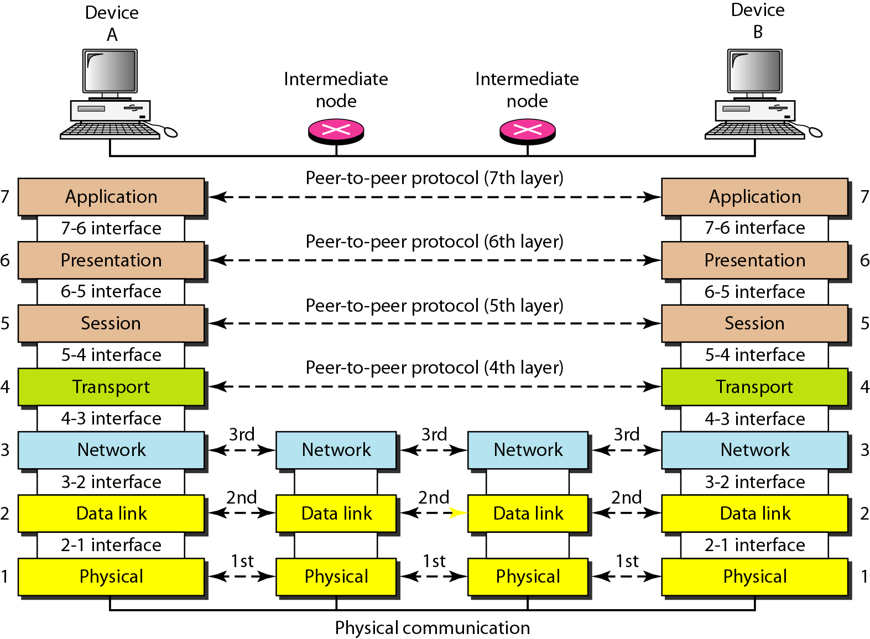
Layers in OSI model

Slide 4
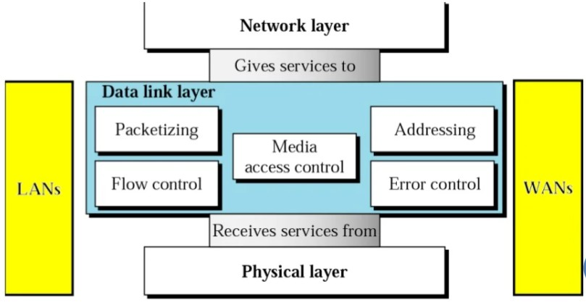
Data Link Layer Overview

Slide 5
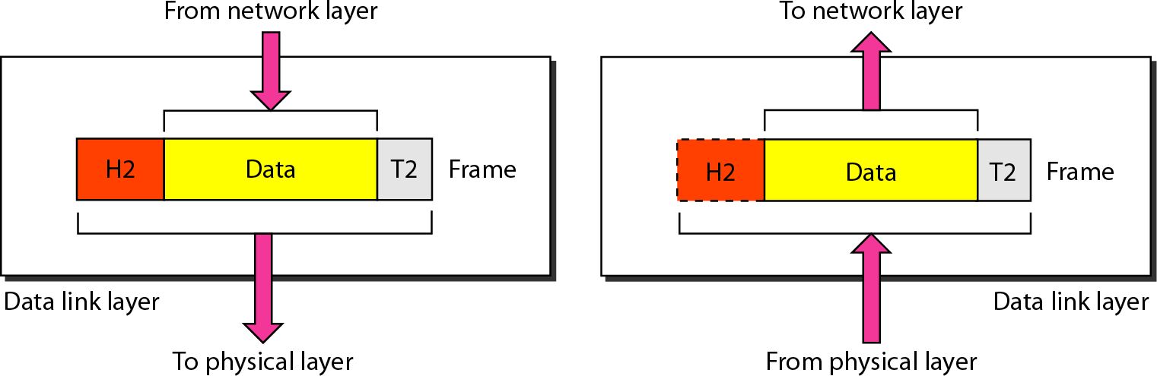
OSI Model: Data Link Layer

Slide 6

Data Link Layer
Algorithms, protocols, and services for achieving reliable, efficient
communication between systems connected by a “wire-like” communication channel
Trivial?
Errors on communication circuits
Finite data rate
Nonzero propagation delay
Finite processing speed

Slide 7
Data Link Layer II
Services to network layer
Services from physical layer
Unacknowledged connectionless service
Acknowledged connectionless service
Acknowledged connection-oriented service
Unreliable bit transport

Slide 8
Data Link Layer : Services
Connectionless service Connection-oriented service
Unacknowledged
Independent frames
Error rate should be low
Recovery left to higher layers
Used on LANs
Acknowledged
No connection
Acknowledgement for each
packet
Resending
Ack is optimisation; also transport layer can handle errors
Acknowledged
Each frame received exactly once
All frames received in the right order
3 distinct phases:
Establishment of connection
Data transfer
Release of connection
Notes:
Unacknowledged Connectionless Service
Frames are sent independently, without any prior connection.
No acknowledgements are sent back for received frames.
It assumes the error rate is very low.
If a frame is lost or corrupted, no recovery is done at this layer.
Error recovery is handled by higher layers (usually the Transport Layer).
Commonly used in LANs where transmission is reliable.
Example idea: Ethernet does not resend frames if one is lost. It simply sends the next frame.
2. Acknowledged Connectionless Service
Still no connection setup, but:
Each frame is individually acknowledged.
If an acknowledgement is not received, the frame is resent.
Improves reliability compared to unacknowledged service.
Acknowledgement here is mainly an optimization, because:
The Transport Layer can also handle errors and retransmissions.
Example idea: Useful on links where errors are more common, such as wireless links.

Slide 9
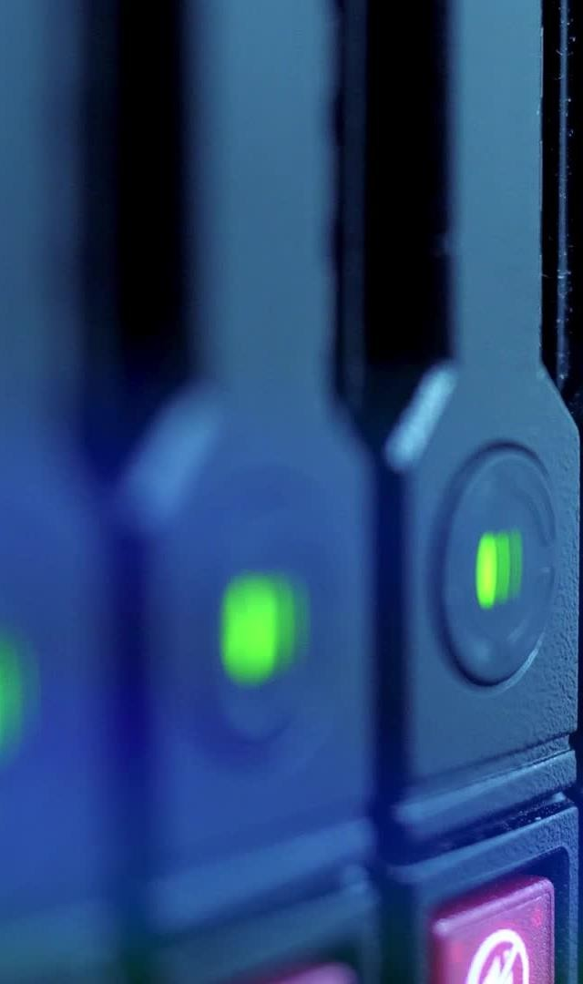
Data Link Layer services
Functions:
Framing: Conversion from raw bit stream into packets. Frame contains header, packets and trailer
Physical Addressing: Providing address to source
and destination device.
Flow Control: Technique through which the constant data rate is maintained on both the sides so that no data get corrupted.
Error Control: Error control is achieved by adding a
calculated value CRC (Cyclic Redundancy Check)
Access Control: Used to determine which device has control over the shared link at a given time.
Notes:
Framing
Framing is the process of converting a raw bit stream into frames.
Each frame consists of:
Header (control and addressing information)
Data (packet) from the Network Layer
Trailer (error detection information)
Framing helps the receiver identify the start and end of a frame.
2. Physical Addressing
The Data Link Layer adds physical (MAC) addresses to the frame.
It provides:
Source address
Destination address
These addresses are used for node-to-node delivery on the same network.
3. Flow Control
Flow control is a technique to regulate the rate of data transmission.
It ensures that the sender does not transmit data faster than the receiver can process.
This prevents buffer overflow and data loss at the receiver.
4. Error Control
Error control ensures reliable transmission of frames.
It is achieved by adding a Cyclic Redundancy Check (CRC) value in the trailer.
The receiver checks the CRC to detect transmission errors.
If an error is detected, the frame may be discarded or retransmitted.
5. Access Control
Access control determines which device can use the shared communication medium at a given time.
It is required in shared or broadcast networks.
Prevents data collision between multiple transmitting devices.

Slide 10
Data Link Layer services: Framing
Framing: break stream of bits up into discrete frames
Methods:
Use of time gap: unacceptable, too risky
Character count
Starting and ending characters with character stuffing
Starting and ending flags with bit stuffing
Physical layer coding violations
Notes:
Framing
Framing is the process of breaking a continuous stream of bits into discrete frames so that the receiver can correctly identify the beginning and end of each frame.
Methods of Framing
1. Use of Time Gap
Frames are separated by time intervals (silence).
If no data is received for a specific duration, it indicates a new frame.
Unacceptable method because:
Network delays are unpredictable.
A delay may be mistaken as a frame boundary.
Hence, it is too risky for reliable communication.
2. Character Count
The header contains a field that specifies the number of characters (bytes) in the frame.
The receiver counts characters to determine the end of the frame.
Problem:
If the count field is corrupted, frame synchronization is lost.
3. Starting and Ending Characters (Character Stuffing)
Special characters are used to mark:
Start of frame
End of frame
If the same character appears in the data, an escape character is inserted before it.
The receiver removes the escape character during reception.
Used in byte-oriented protocols.
4. Starting and Ending Flags (Bit Stuffing)
Frames are delimited using a special bit pattern (flag), usually 01111110.
If the same pattern appears in data:
A 0 is inserted after five consecutive 1s.
The receiver removes the extra 0.
Used in bit-oriented protocols like HDLC.
5. Physical Layer Coding Violations
Certain unused or illegal signal patterns at the Physical Layer are used to indicate:
Start of frame
End of frame
These patterns do not appear in normal data.

Slide 11
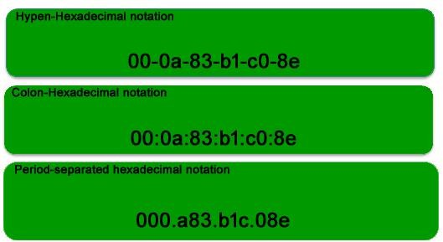
Data Link Layer services: Physical addressing
The physical address, also known as the link address, is the address of a node as defined by its LAN or WAN. It is included in the frame used by the data link layer. It is the lowest-level address.
The size and format of these addresses vary depending on the network.
For example, Ethernet uses a 6-byte (48-bit) 12 hexadecimal digits physical address that is imprinted on the network interface card (NIC).
Notes:
Physical Address (Link Address)
A physical address, also called a link address, is the address of a node as defined by its LAN or WAN.
It is included in the frame created by the Data Link Layer.
This address is used for node-to-node delivery within the same network.
It is the lowest-level address in the networking hierarchy.
Characteristics of Physical Address
The size and format of physical addresses vary from one network technology to another.
Physical addresses are hardware-based, not logical.
They are typically assigned by the manufacturer of the network interface.
Example: Ethernet Physical Address
Ethernet uses a 6-byte (48-bit) physical address.
It is represented as 12 hexadecimal digits Example format: AA-BB-CC-DD-EE-FF
This address is imprinted on the Network Interface Card (NIC).
Key Point for Exams
Physical addresses operate at the Data Link Layer and are different from logical (IP) addresses, which operate at the Network Layer.

Slide 12
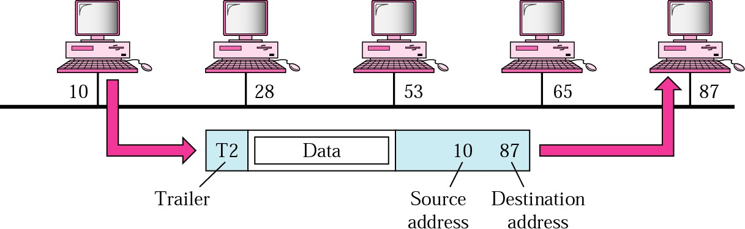
Data Link Layer services: Physical Addressing
Example:
A node with physical address 10 sends a frame to a node with physical address 87. At the data link level this frame contains physical addresses in the header. The trailer usually contains extra bits needed for error detection
Notes:
Example: Physical Addressing at Data Link Layer
A node with physical address 10 sends a frame to a node with physical address 87.
At the Data Link Layer, the frame header contains:
Source physical address: 10
Destination physical address: 87
The data field carries the packet received from the Network Layer.
The trailer usually contains extra bits for error detection, such as CRC.

Slide 13
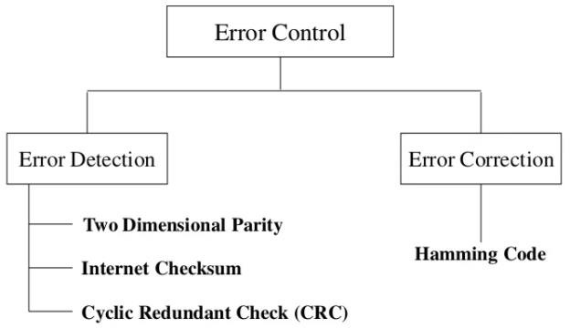
Data Link Layer services: Error Control
Error control
How does a sender know that all packets are correctly received?
ACK packet by receiver
Packet lost or not recognized at receiver?
Timer at sender: resend packet
How to handle duplicates or out of order received packets?
Sequence number in packet and ACK packet
Optimisation: NACK packet
Inform sender that something strange happened
Notes:
Error Control (Data Link Layer)
Error control ensures that frames are delivered correctly, in order, and without duplication between two directly connected nodes.
1. How does the sender know that packets are correctly received?
The receiver sends an ACK (Acknowledgement) packet for each correctly received frame.
Receiving an ACK confirms successful delivery.
2. What if a packet is lost or not recognized by the receiver?
The sender starts a timer after transmitting a frame.
If an ACK is not received before the timer expires:
The sender assumes the frame is lost or corrupted.
The sender resends the packet.
3. How are duplicate or out-of-order packets handled?
Each packet is assigned a sequence number.
Sequence numbers are included in:
The data packet
The ACK packet
This allows the receiver to:
Detect duplicate frames
Restore the correct order of packets
4. Optimization Using NACK
Instead of waiting for a timeout, the receiver may send a NACK (Negative Acknowledgement).
A NACK informs the sender that:
A specific packet was not received correctly
Or something unusual occurred
This allows faster retransmission and improves efficiency.
Key Exam Point
Error control at the Data Link Layer provides hop-to-hop reliability, while end-to-end reliability is handled by the Transport Layer.

Slide 14
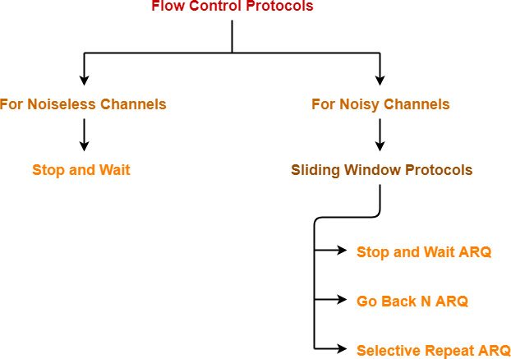
Data Link Layer services: Flow Control
Flow control
A technique that observes proper flow of data from sender to receiver.
Flow control gives permission to two of stations that are working and processing at different speeds to just communicate with one another.
It restricts and coordinates number of frames or amount of data sender can send just before it waits for an acknowledgment from receiver.
The receiving should inform the sender about stopping the transmission or transferring of data on temporary basis before it reaches limit.

Slide 15
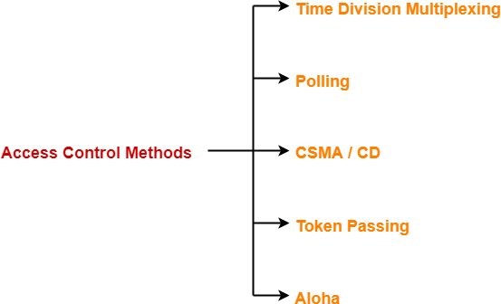
Data Link Layer services: Access Control
Access Control is a mechanism that controls the access of stations to the transmission link.
To prevent the occurrence of collision or if the collision occurs, to deal with it.
Multiple stations place their data packets on the link
and starts transmitting simultaneously.
Such a situation gives rise to a collision among the data packets.
Collision of data packets causes the data to get
corrupt
Access control methods are the methods used for providing access control and they prevent the collision or deal with it and ensures smooth flow of traffic on the network.

Slide 16
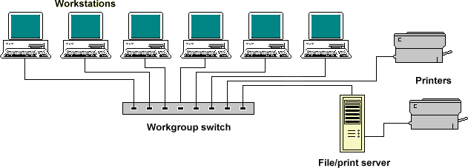
Switch
A switch is a multiport bridge with a buffer and a design that can boost its efficiency(a large number of ports imply less traffic) and performance.
A switch is a data link layer device.
The switch can perform error checking before forwarding data, which makes it very efficient as it does not forward packets that have errors and forward good packets selectively to the correct port only.
Switch divides the collision domain of hosts, but broadcast domain remains the same.

Slide 17
Switch : Functions
Switch performs multiple functions based on the MAC address (physical address) of a device.
An entry in the switch MAC table, also known as CAM (Content Addressable Memory), can remain up to 300 seconds
MAC table has 4 entries:
Port Number – The switch port is attached to the destination MAC.
MAC Address – MAC address of that host which is attached to that switch port.
Type – It tells us about how the switch has learned the MAC address of the host i.e static or dynamic. If the entry is added manually then it will be static otherwise it will be dynamic.
VLAN – It tells about to which VLAN the host, attached to that switch port, belongs.

Slide 18
Switch : Functions
Learning – The switch learns the MAC address of the device on the switch port on which it receives the frame.
Forwarding – The switch does 2 types of message forwarding:
Unicast: The switch unicasts the frame to the destination only when it has an entry for destination MAC address in its MAC address table.
Unknown Unicast: When a switch receives a unicast frame for a destination for which the switch has no entry in its MAC table then the switch simply broadcasts the frame through all ports. This is known as flooding.
Filtering – The frame will be forwarded through that switch port only for which the
switch has already learned the MAC address in its MAC table.
Loop avoidance – For redundancy, two switches are connected to each other through two links which can also result in layer 2 loops. These loops are avoided by switching by using the STP(Spanning tree protocol) protocol.

Slide 19
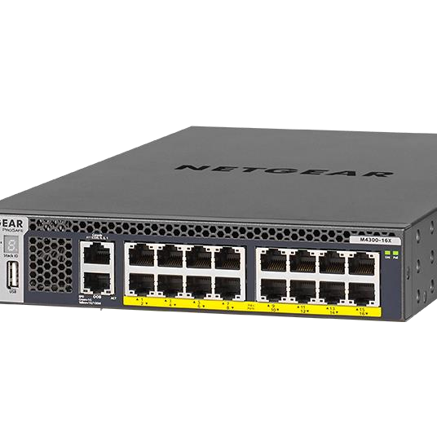
Switch : Types
Managed switch –
It has highest levels of security, precision control, and full management of the network. These are used in organizations containing a large network and can be customized to enhance the functionality of a certain network. It is costly but the scalability makes it an ideal option for a growing network. It is used in SNMP.
Types:
Smart switches: Offers basic management features with the ability to create some levels of security and is often called partially managed switches. It is mostly used in fast and constant LANs which support gigabit data transfer and allocations and in VLANs .
Enterprise managed switches: It has features like the ability to fix, copy, transform and display different network configurations, along with a web interface SNMP agent and command-line
interface. These are also known as and
fully managed switches
are more expensive. It can be used in organizations that contain many ports, switches, and nodes.

Slide 20
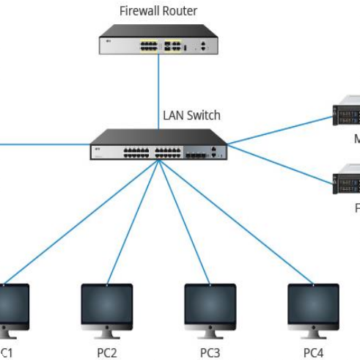
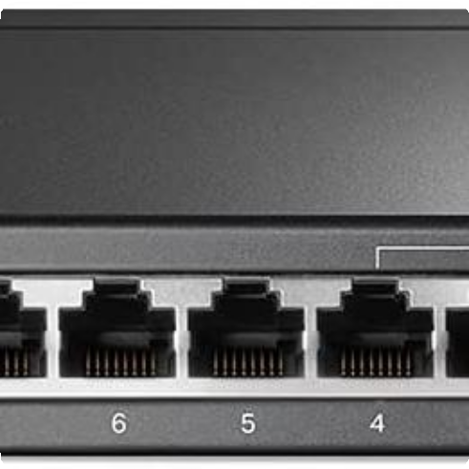
Switch : Types
Unmanaged switches –
Used in home networks and small businesses as they plug in and instantly start doing their job and such switches do not need to be watched or configured.
These require only small cable connections.
It allows devices on a network to connect with each other such as a computer to a computer or a computer to a printer in one location. They are the least expensive switches among all categories.
LAN switches –
Ethernet switches or data switches and are used to reduce network congestion or bottleneck by distributing a package of data only to its intended recipient.
PoE switches –
Used in PoE (Power over Ethernet) technology that integrates data and power on the same cable allowing power devices to receive data in parallel to power. These switches provide greater flexibility by simplifying the cabling process.

Slide 21
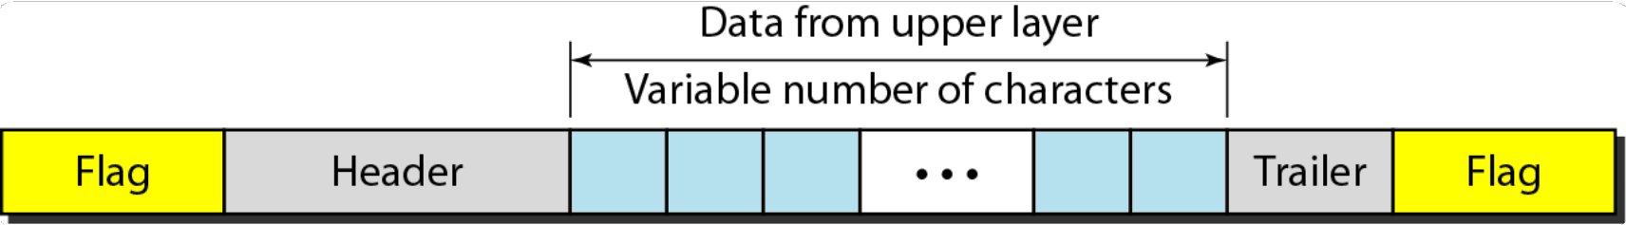
Frames are the units of digital transmission in computer networks and
telecommunications.
It is comparable to the packets of energy called photons in case of light.
DLL needs to pack bits into frames, so that each frame is distinguishable
from another.
Postal system practices a type of framing. Inserting a letter into an envelope separates one piece of information from another; the envelope serves as the delimiter.
It provides a way for a sender to transmit a set of bits that are meaningful
to the receiver.
Frame is continuously used in Time Division Multiplexing process.
Framing

Slide 22
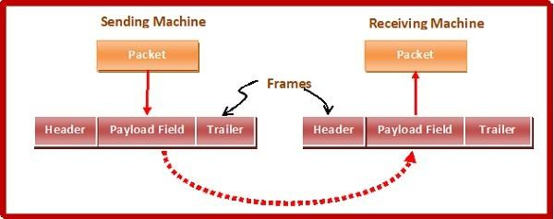
Framing
Ethernet, token ring, frame relay, and other data link layer technologies have their own frame structures.
Frames have headers that contain information such as error-checking codes.
It extracts message from sender and provide it to receiver by providing sender’s and receiver’s address.

Slide 23
Framing Application
Data is broken up into recoverable chunks that can easily be checked for corruption.
A frame is the event's complete cycle within the period division in time-division
multiplexing.
In playback, video, and film recording, a frame is a general image in a series of images that can be played back and recorded.
In a computer video display, a frame is an image that is transferred to a display image delivering device. Continuously, it is refreshed and updated through the frame buffer. It is a highly accessible video RAM part.
In Artificial intelligence applications, the frames are a group of data along with details about a specific image, process, and object. An example of this type of frame is the iris- print visual recognition system utilized to recognize users of various bank ATMs. This system then compares the data frame for a user using the frame within its authorized user's database.

Slide 24
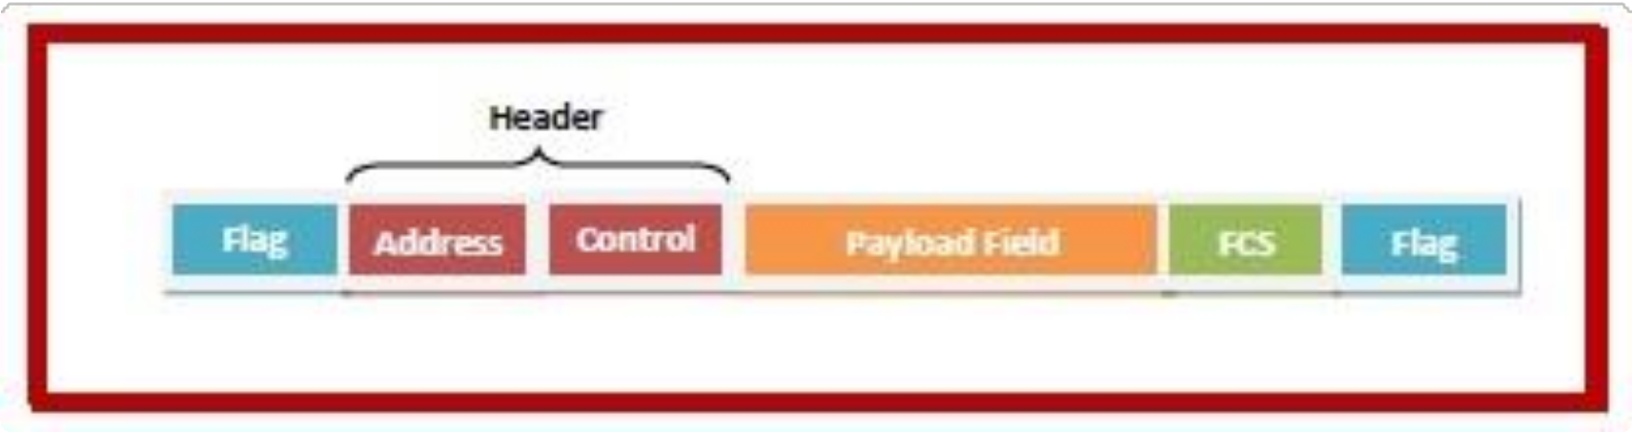
Flag: It points to the starting and completion of the frame.
Trailer: It includes the error correction and end detection bits.
Payload field: It includes the messages to be rendered.
Frame Header: It includes the origin and the target addresses of a
frame.
Frame components

Slide 25
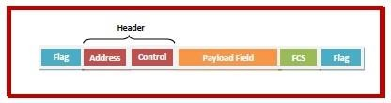
Frame components: Frame header
Frame Header: It includes the source address, destination address, and three of the main control fields discussed below:
ack: It includes the acknowledgment number of a few frames when piggybacking is applied.
seq: It includes the sequence number of a frame for re-adjustment of various out-of-sequence
frames. This field is also used for sending acknowledgments through the receiver.
kind: It includes states whether a frame is any data frame or the frame is applied for many control functions such as link management or flow and error control etc.

Slide 26
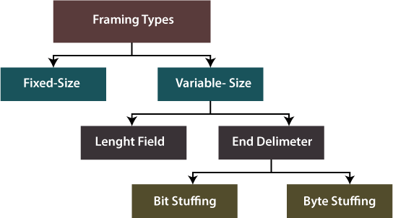
Types of Framing : Fixed size framing
Fixed size framing: The frame is of fixed size and there is no need to provide boundaries to the frame, length of the frame itself acts as delimiter.
Drawback:
It suffers from internal fragmentation if data size is less than frame size
Solution: Padding

Slide 27
Types of Framing : Variable size framing
There is no requirement to describe frame end as well as starting of the upcoming frame
to characterize this type of framing.
It could be implemented in two different forms:
Length field: In a frame, we can define the length field to show the length of a frame. It is applied in the Ethernet (802.3). The issue with it is that the length field may get corrupted sometimes.
ED (End Delimiter): In a frame, we can address an end delimiter to show the completion of a frame. It is applied in the Token Ring. The issue with it is that the end delimiter can appear in the data.
Bit Stuffing: An arrangement of bits of random length can be stuffed in a message for differentiating through the delimiter. Also, it is known as bit-oriented framing.
Byte Stuffing: The bytes are stuffed in a message for differentiating through the
delimiter. Also, it is known as character-oriented framing.

Slide 28
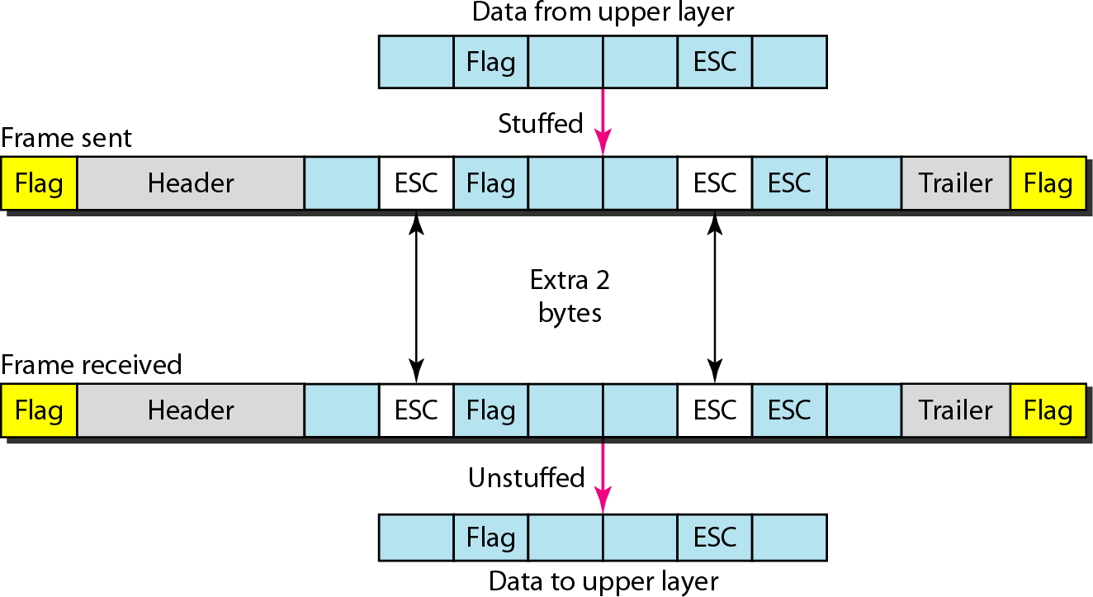
Variable size framing: Byte stuffing
Byte Stuffing: Byte stuffing is the process of adding 1 extra byte whenever there is a flag or escape character in the text.
If data contains ED then, byte is stuffed
into data to differentiate it from ED.
Let ED = “$” and the data contains ‘$’ anywhere then it can be escaped using ‘\O’ character.
If data contains ‘\O$’ then, use ‘\O\O\O$’ ($ is escaped using \O and \O is escaped using \O).

Slide 29
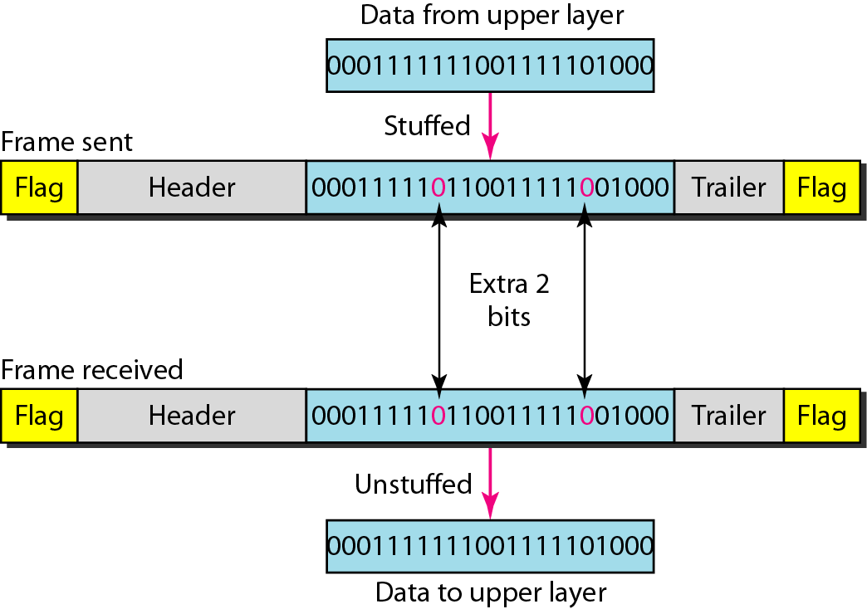
Variable size framing: Bit stuffing
Bit Stuffing: Bit stuffing is the process of adding one extra 0 whenever five consecutive 1s follow a 0 in the data, so that the receiver does not mistake the pattern 0111110 for a flag.
Let ED = 01111 and if data = 01111 then sender stuffs a bit to break the pattern i.e., here appends a 0 in data 011101.
Receiver receives the frame and if data contains 011101, receiver removes the 0 and reads the data

Slide 30
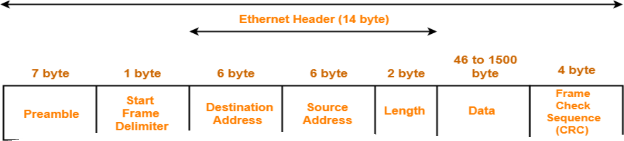
Frames Example : Ethernet Frame
PREAMBLE –This is a pattern of alternative 0’s and 1’s which indicates starting of the frame and allow sender and receiver to establish bit synchronization. Initially, PRE (Preamble) was introduced to allow for the loss of a few bits due to signal delays.
Start of frame delimiter (SFD) – This is a 1-Byte field which is always set to 10101011.
Destination Address – This is 6-Byte field which contains MAC address of destination.
Source Address – This is a 6-Byte field which contains the MAC address of source machine.
Length – The length of entire Ethernet frame is 16-bit field can hold the length value between 0 to 65534, but length cannot be larger than 1500 because of some own limitations of Ethernet.
Data – Payload which can be of minimum 46 byte and maximum 1500 byte.
Cyclic Redundancy Check (CRC) – CRC is 4 Byte field which is a hash code of data. If the checksum
computed by destination is not the same as sent checksum value, data received is corrupted.

Slide 31
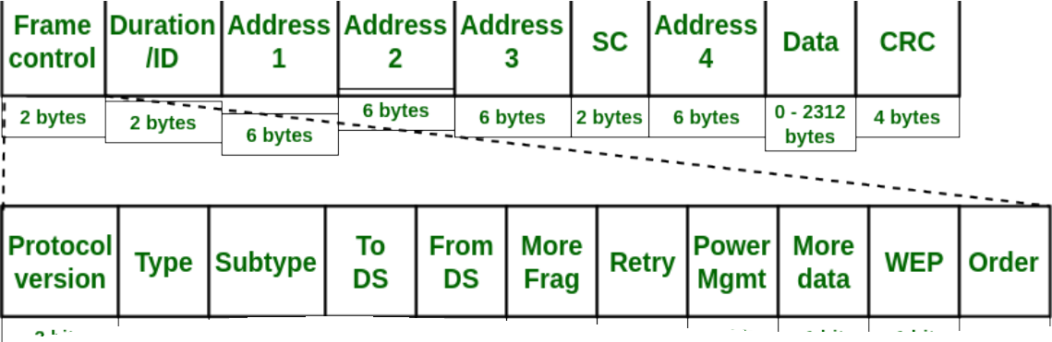
Frames Example : WiFi
Frame Control(FC) – It defines type of frame and some control information
Version: current protocol version, Type: Determines the function of frame i.e management(00), control(01) or data(10). The value 11 is reserved. Subtype: 0000 for association request, 1000 for beacon., To DS: Indicates that destination frame is for DS(distribution system), From DS, More frag (More fragments): It is set to 1 means frame is followed by other fragments, Retry, Power Mgmt (Power management): Set to 1 the field indicates that the station goes into power-save mode. If the field is set to 0, the station stays active, More data: Indicate receiver that a sender has more data to send than the current frame. WEP: Indicates that the standard security mechanism of 802.11 is applied. Order: If this bit is set to 1 the received frames must be processed in strict order.
Duration/ID – Period of time in which the medium is occupied(in µs).
Address 1 to 4 – IEEE 802 MAC addresses (48 bit each).
SC (Sequence control) –Sequence number (12 bits) and Fragment number (4 bits).

Slide 32
References
https://www.youtube.com/watch?v=pi7mMjiixiY
https://www.javatpoint.com/frame
https://www.youtube.com/watch?v=NhpzBldHOYo
https://www.youtube.com/watch?v=sdYDLip2ANI
https://www.geeksforgeeks.org/switch-functions-at-layer-2/
https://www.geeksforgeeks.org/types-of-switches-in-computer-network/?ref=lbp

